Slide 1
Group 11
Anh Nguyen
Seth Lemar
Bryan Strohmeyer
Stephen Peterson

Slide 2
Dataset Overview and Variable description
IMDb rates movies on a scale from 1 to 10 using the feedback and voting from all registered users
User and critic are reviews are available on the website as well
This dataset of 5000+ movies compares each film with variables and information from the website database
There are in total 28 variables and 5043 observations
Variables are a mix of numerical and categorical
Variables we chose to work with include 4 numerical:
  Duration
  # of critics for reviews - gives the number of critical reviewers for each movie
  # of users for reviews - gives the number of user reviewers for each movie
  # of voted user - gives the numbers of users who voted in each movie’s IMDb score
Categorical Variable:
  Language - Foreign/English

Slide 3
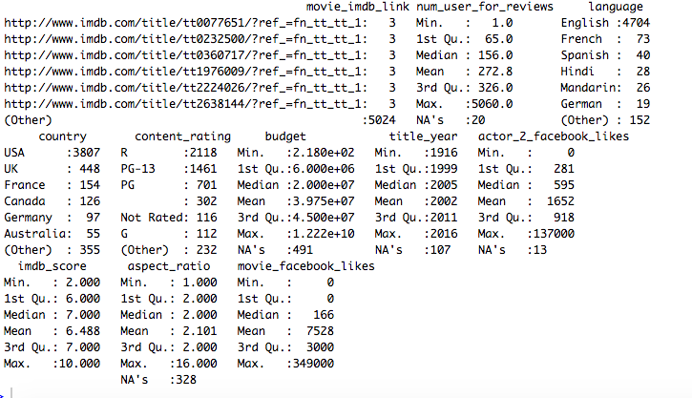
Summary Statistics
Notes:
As we can see the, the summary of the statistics output each variables with their descriptive statistics (min, max, 1st quantiles,...). We also notice how much of the data is NA or missing. For example...

Slide 4
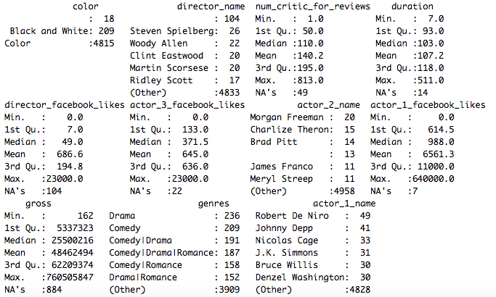
Summary Statistics (cont)

Slide 5
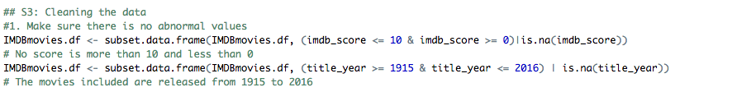
2. Cleaning the data
We make sure that no data is abnormal is included in the analysis, since, it will seriously skew the data.
=> There was not significant abnormal data, so the condition of the dataset stays the same

Slide 6
3. Handling Missing data
We handle missing data based on these principles:
If the missing data is in a numeric variable, we fill in the blank cells with the median of the rest of the data in that variable
If the missing data is in a categorical variable, and the number of cells missing data is a lot less than 3%, we delete those cell.
If the missing data is in a categorical variable, and the number of cells missing data is more than 3%, we leave them alone.
If the missing data is in a variable which we don’t care about (Like IMDB link), we leave it alone

Slide 7
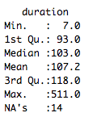
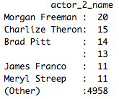
Examples of missing/NA data

Slide 8
Results:
=> We deleted 139 observations from the dataset, about 2.75% of the total number of observations. We consider this acceptable

Slide 9
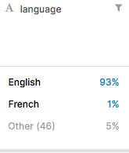
4. Creating a dummy variable
We chose to turn the categorical variable Language (93% English, 1% French, 6% others) to a binary numerical English (1 or 0)

Slide 10
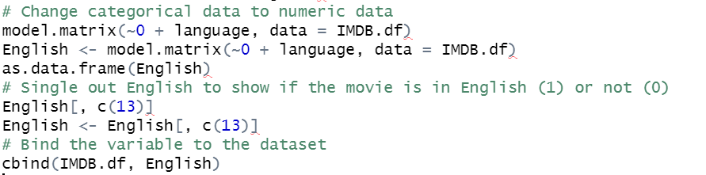
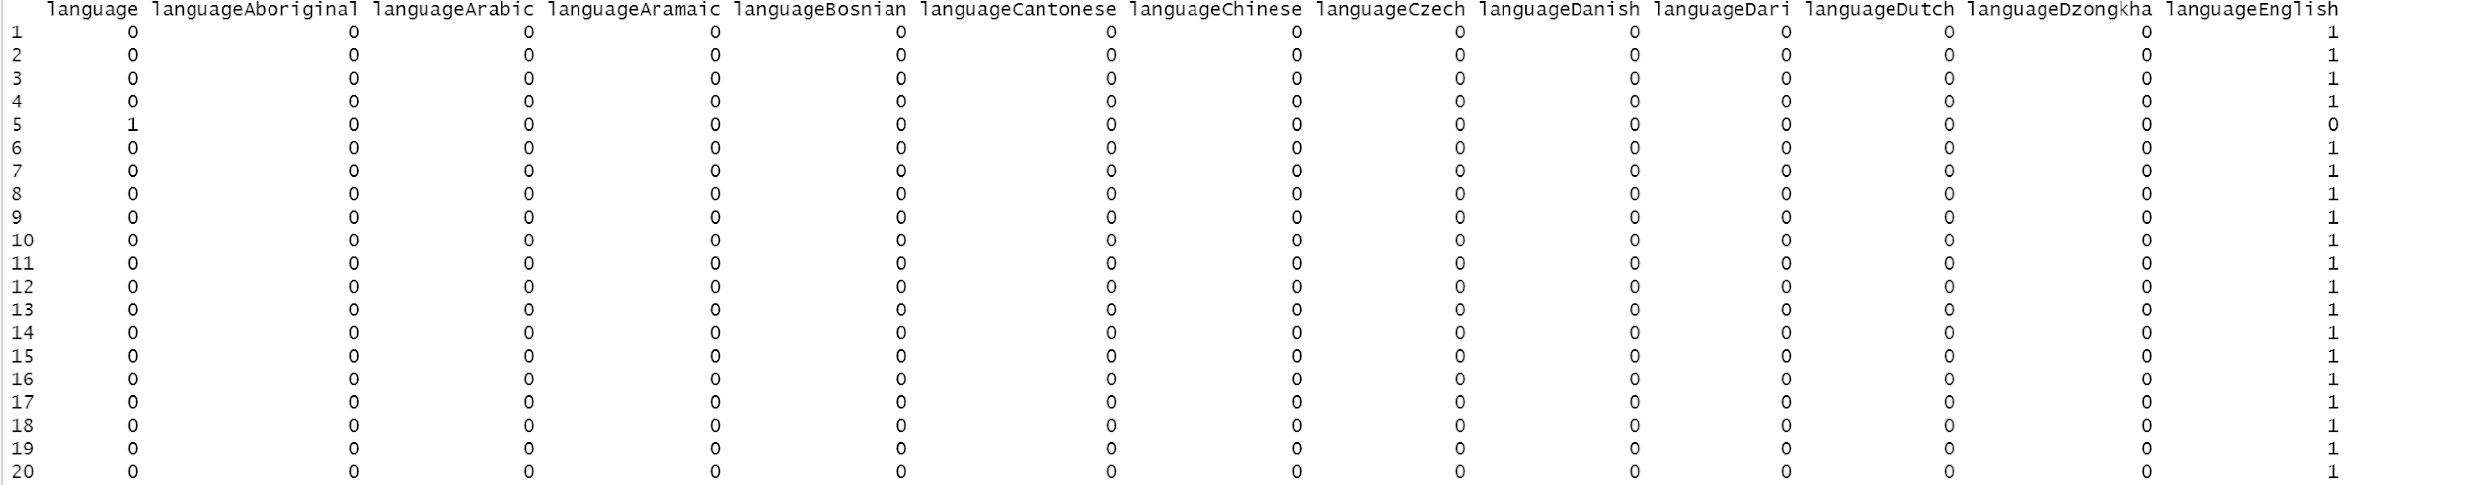
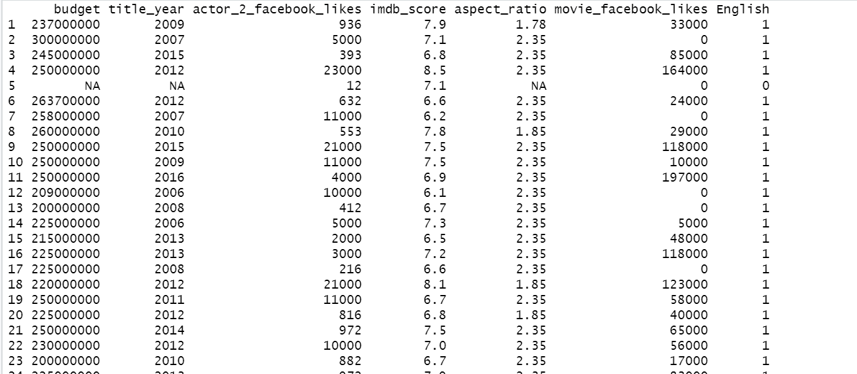
4. Creating a dummy variable (cont)

Slide 11
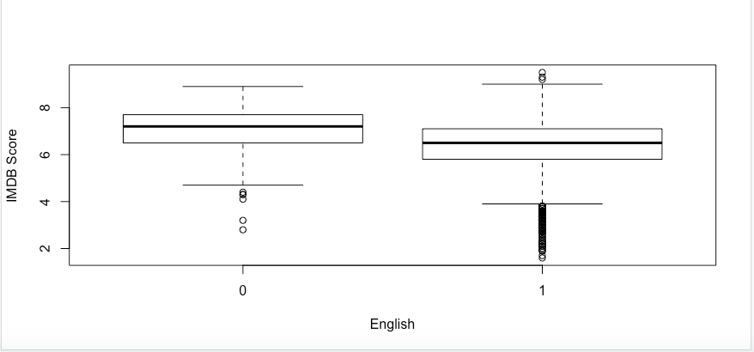
Results of the dummy variable
Notes:
Once we look past the outliers (the open circles above or below each box plot) it shows that the non-English movies generally perform better. The maximum for English is slightly higher but the minimum, lower quartile, median and upper quartile values are much higher for movies that are not english as oppose to those that are in English.

Slide 12
5. Heat map/Correlation table
We create a correlation table between all numerical variables
https://drive.google.com/file/d/132-wiUJJ4Ib6edjcWptPjlx8VVfLxpRs/view?usp=sharing

Slide 13
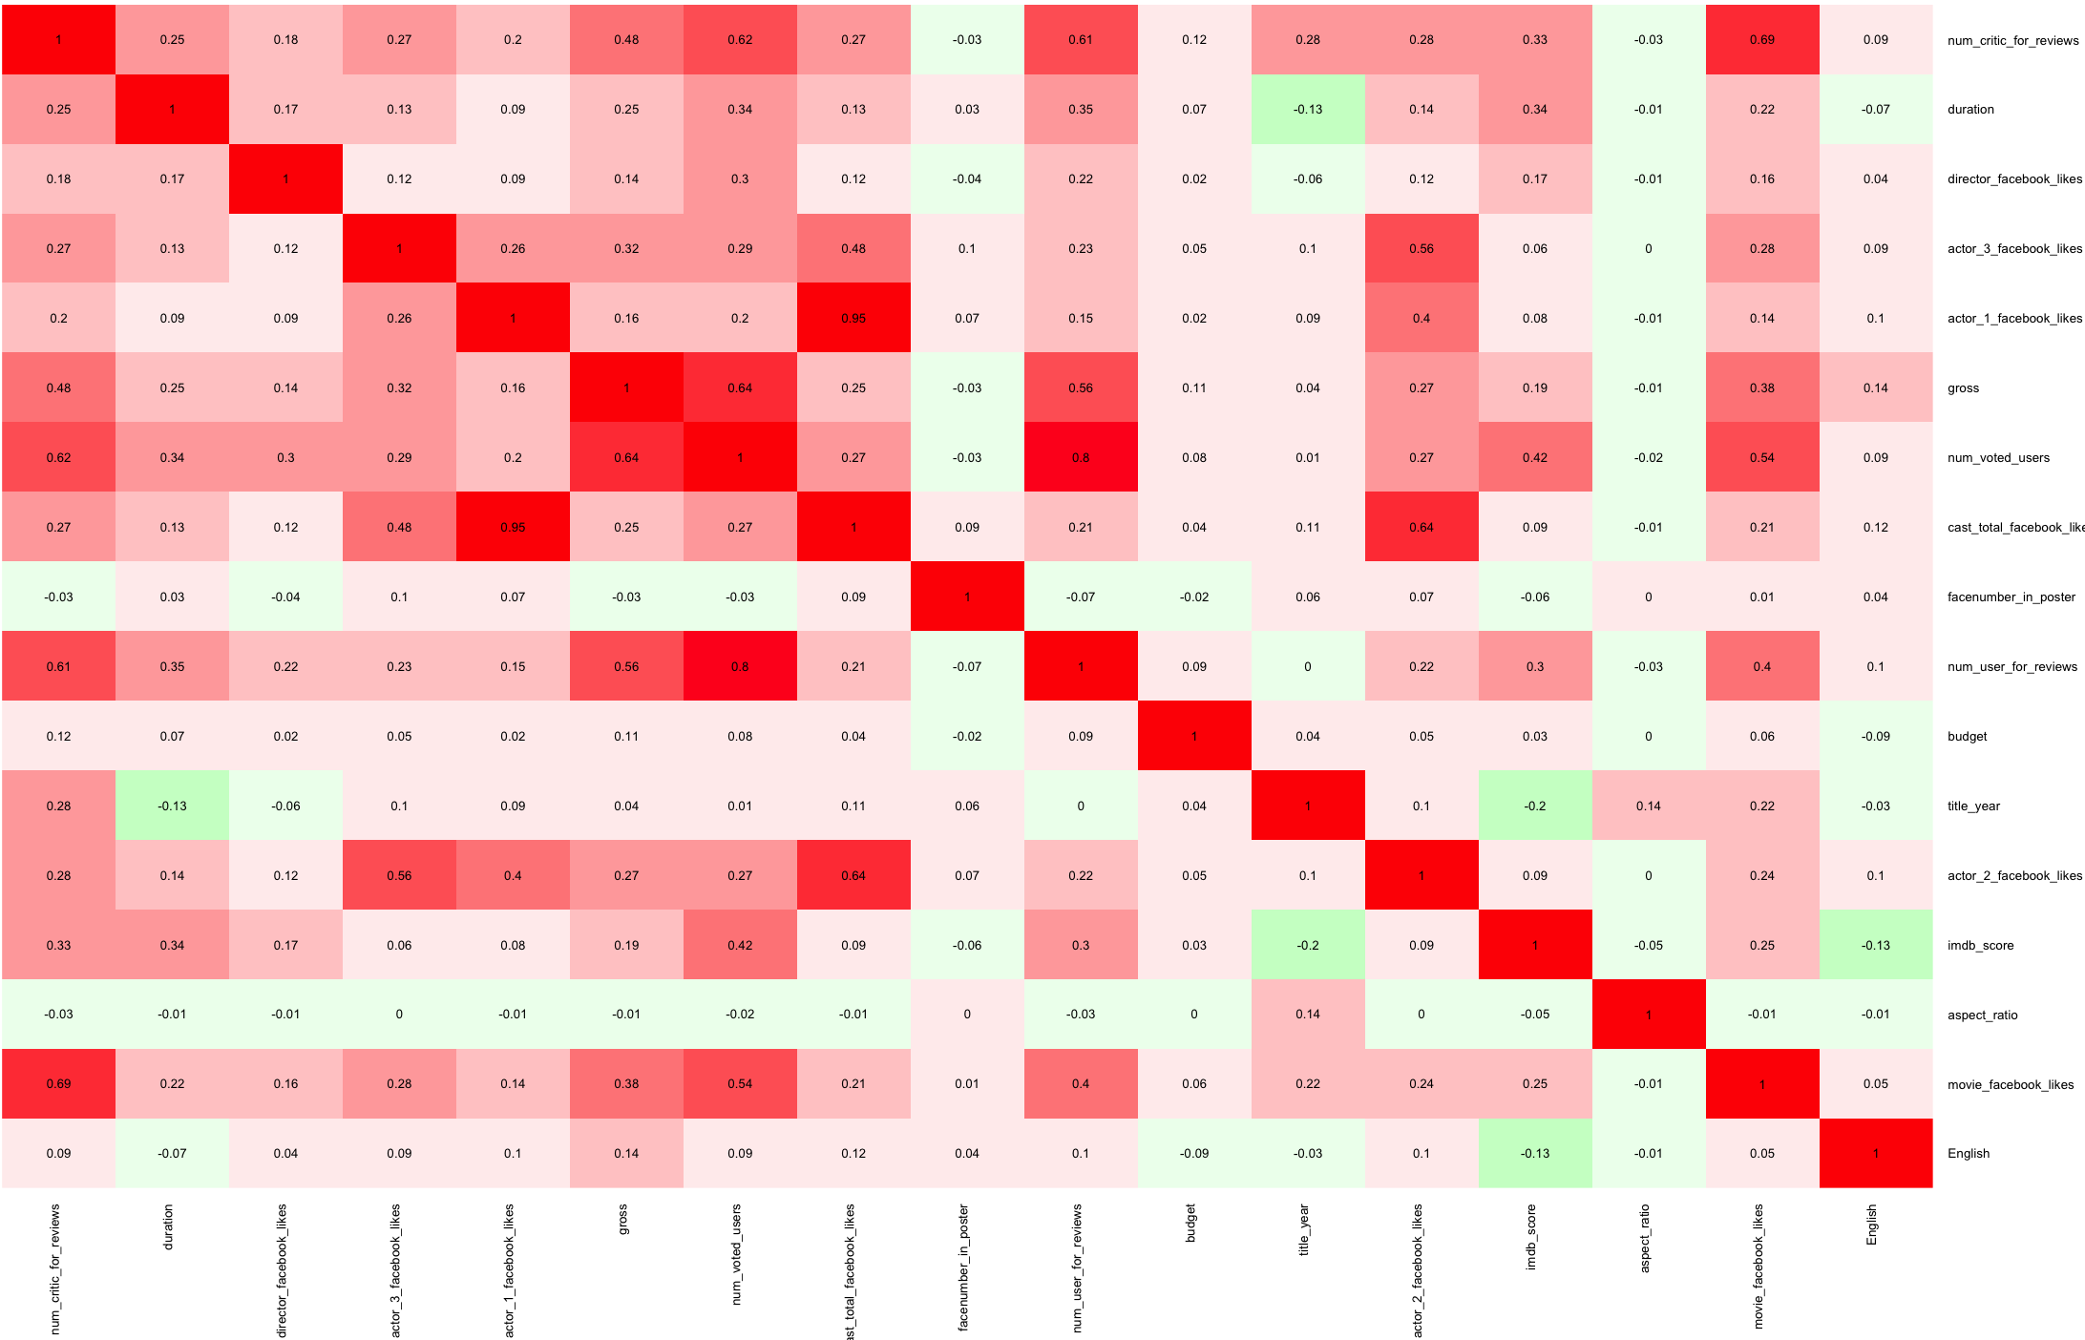

Slide 14

5. Heat map/Correlation table
The purpose was to use these variables to predict a movie IMDB score, so we would only care about the correlation with IMDB_score. We found out these
significant correlation:
- num_voted_users: 0.43
- duration: 0.34
- num_critic_for_reviews: 0.33
- num_users_for_reviews: 0.31
=> These are not strong correlation, but there’s not better alternatives
⇒ => Therefore we chose to make charts to delve deeper into these variables

Slide 15
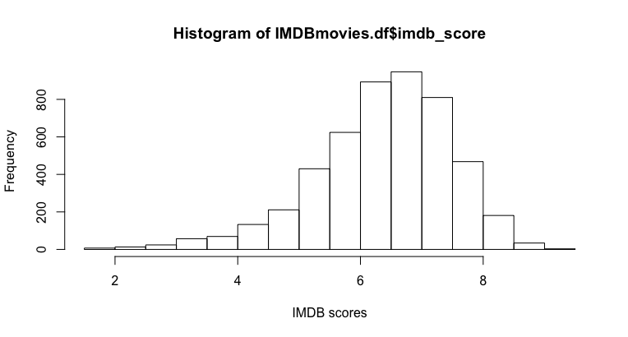
Exploring IMDB score
Notes:
From what we can see, the IMDB score is normally distributed, a bit skewed to the right. Most scores are roughly around 6.5 and 7

Slide 16
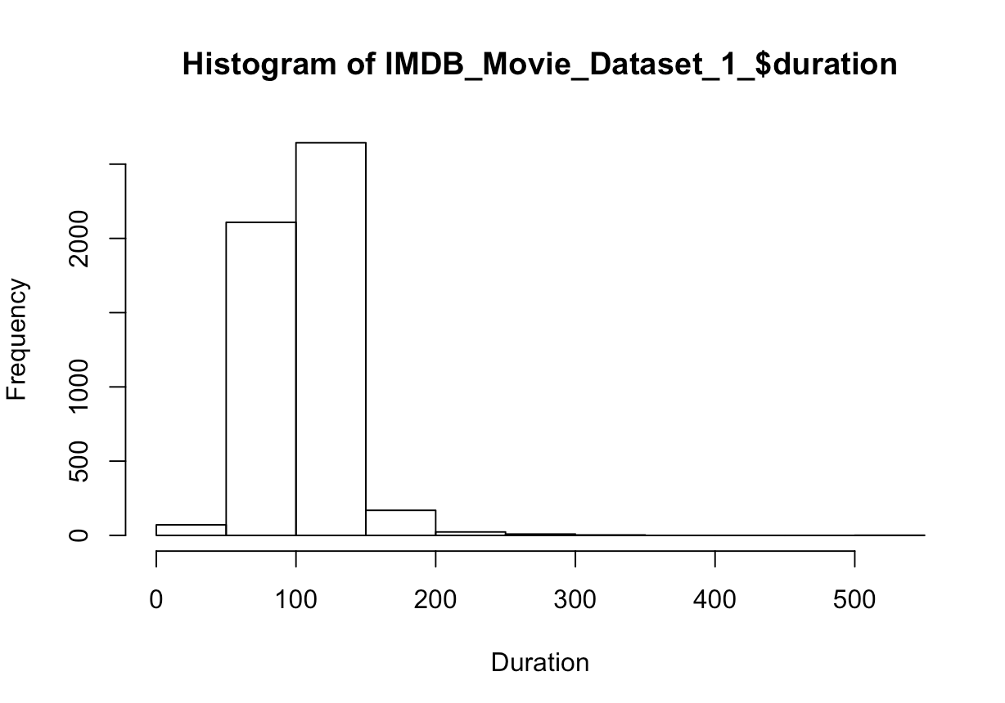
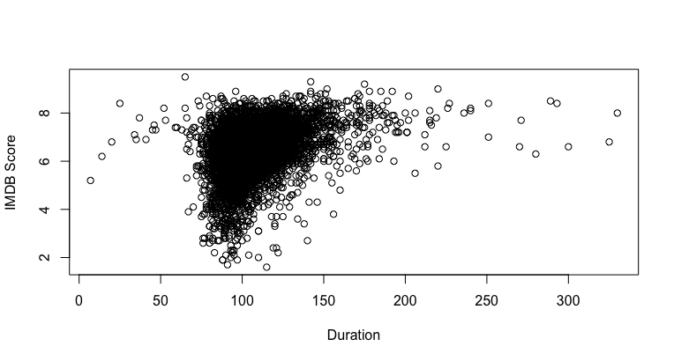
Duration vs. IMDb Score
Scatterplot of Duration of Movie vs. IMDb Score
Notes:
From what we’ve seen above, most durations are from 100 to 150 minutes, which are standards in the industry. From the scatter plot however, we find that for movies 125+ minutes long, the general score is better than 6.

Slide 17
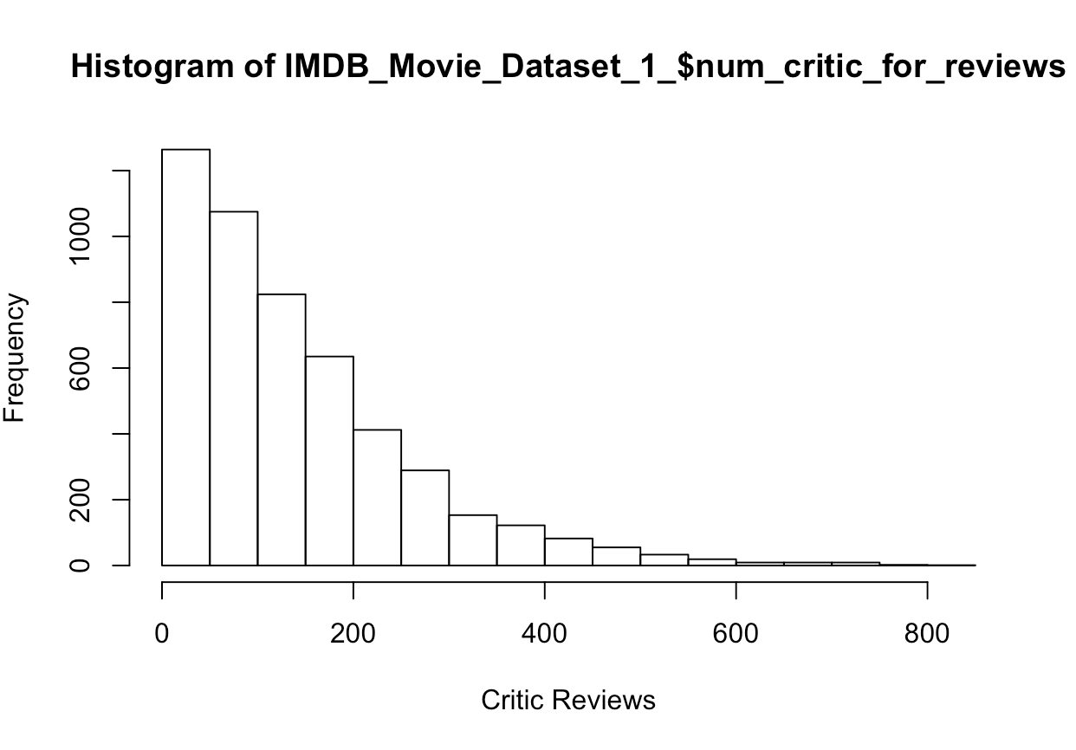
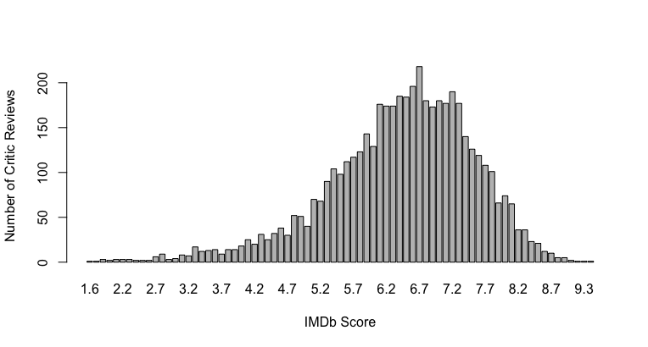
Number of Critic Reviews vs. IMDb Score
Bar Chart of IMDb Score vs. Critic Reviews
Notes:
Most number of critics reviews are in in the range of 200. And we also find critics reviews movies from the range 6.2 to 7.7 the most. (Better IMDB scores does not guarantee more attention from critics.)

Slide 18
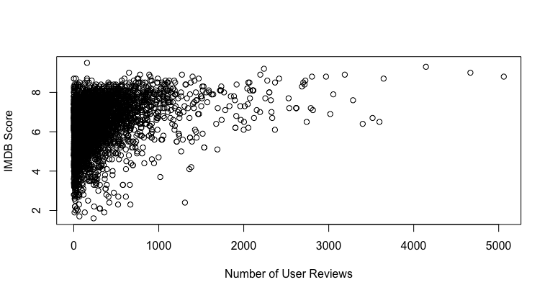
Number of User Reviews vs. IMDb Score
Notes:
Here we have number of user reviews. We find that better movies (higher IMDB scores) will have more people reviewing them. This makes sense, since better movies illicit more strong positive emotions, thus making more people want to review them

Slide 19
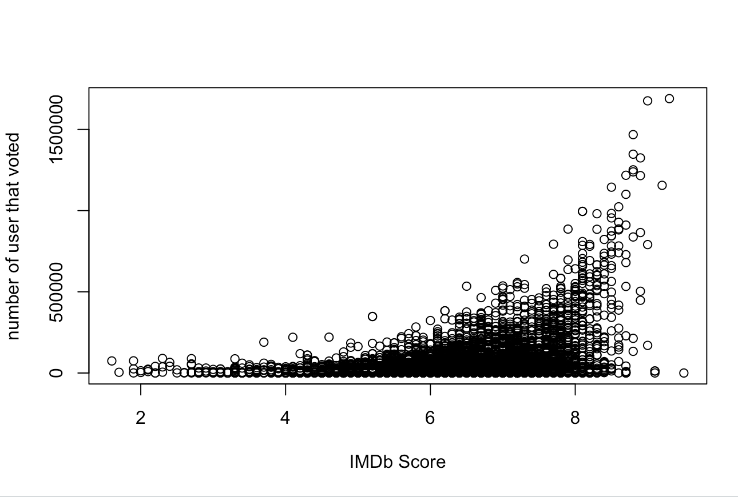
Number of User Votes vs. IMDb Score
Notes:
Number of votes ~ IMDB score is a exponential growth function. This echos the knowledge we learned previously. The better the movie (higher IMDB score), the more people watch it and feel compelled to rate it on IMDB

Slide 20
Conclusions
We found weak positive correlations towards the IMDb score with each of the numerical variables we chose
The number of reviewers critic or otherwise has a strong positive correlation with how high the movie scores in IMDb
From our research on film language we concluded that most popular films are made for an english speaking audience. 93% English, 7% Foreign
From our research on film duration we found that there is a bell curve shape when compared to viewer enjoyment
This meaning, films that are very short and long are less popular than those with a run time between 90 and 120 minutes
Notes:
(Also, please check out the notes from previous slides)

